Slide 1
Lab 08 – Wireless LAN
201910774 김건

Slide 2
Wireless LAN
Click open “trace-80211.pcap”
Find a Data frame in the trace and select it.
Inspect the protocol layers
Radiotap is a record created by Wireshark to capture physical layer parameters, such as the strength of the signal and the modulation.

Slide 3
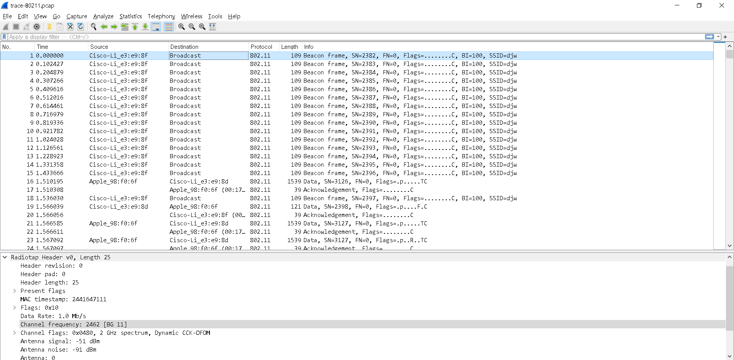
Wireless LAN
Answer the questions:
What is the channel frequency? And what are the meanings of the channel frequency & channel number?
To find the frequency, expand the Radiotap header of any frame and look for the Channel frequency.
채널 주파수는 2462 MHz이고, 채널 번호는 11번이다.
채널 번호는 주파수 대역 안에서 5MHz씩 채널 간격을 나눴을 때 해당하는 채널 각각의 번호이고, 주파수는 그 채널의 주파수를 의미한다.

Slide 4
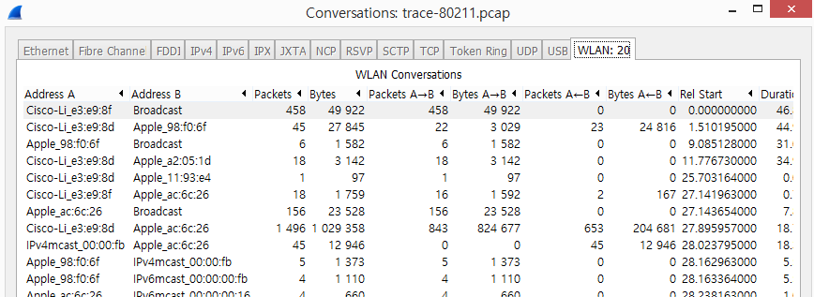
Wireless LAN
Statistics → Conversation → WLAN tab
You can sort this list by size by clicking on the Packets or Bytes column headings.

Slide 5
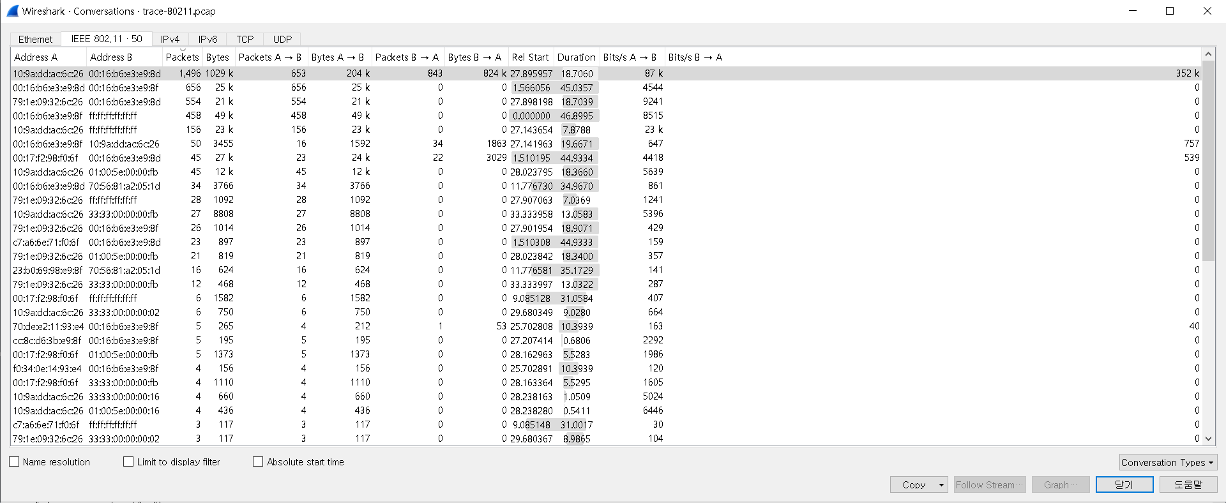

Wireless LAN
What is the BSS ID used by the wireless conversations with the largest packet number?
A BSS ID value identifies an AP, so this BSS ID identifies the most active AP, presumably the AP we are monitoring. To help find it, you can sort on the source or destination address by clicking on the column heading.
가장 활성화된 패킷의 BSS ID는 Cisco-Li_e3:e9:8d 이다.
Name resolution 옵션을 체크함으로써 Address B가 AP임을 추측해 볼 수 있었다.

Slide 6
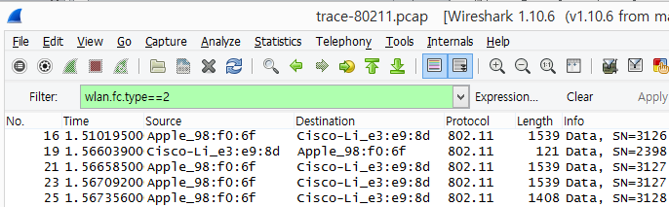
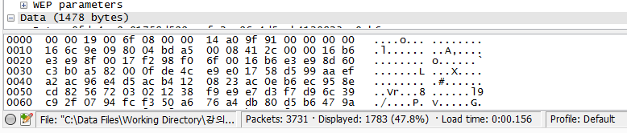
Wireless LAN: Data frame
You can filter only Data frames.
Or wlan.fc.type==“data frame”

Slide 7
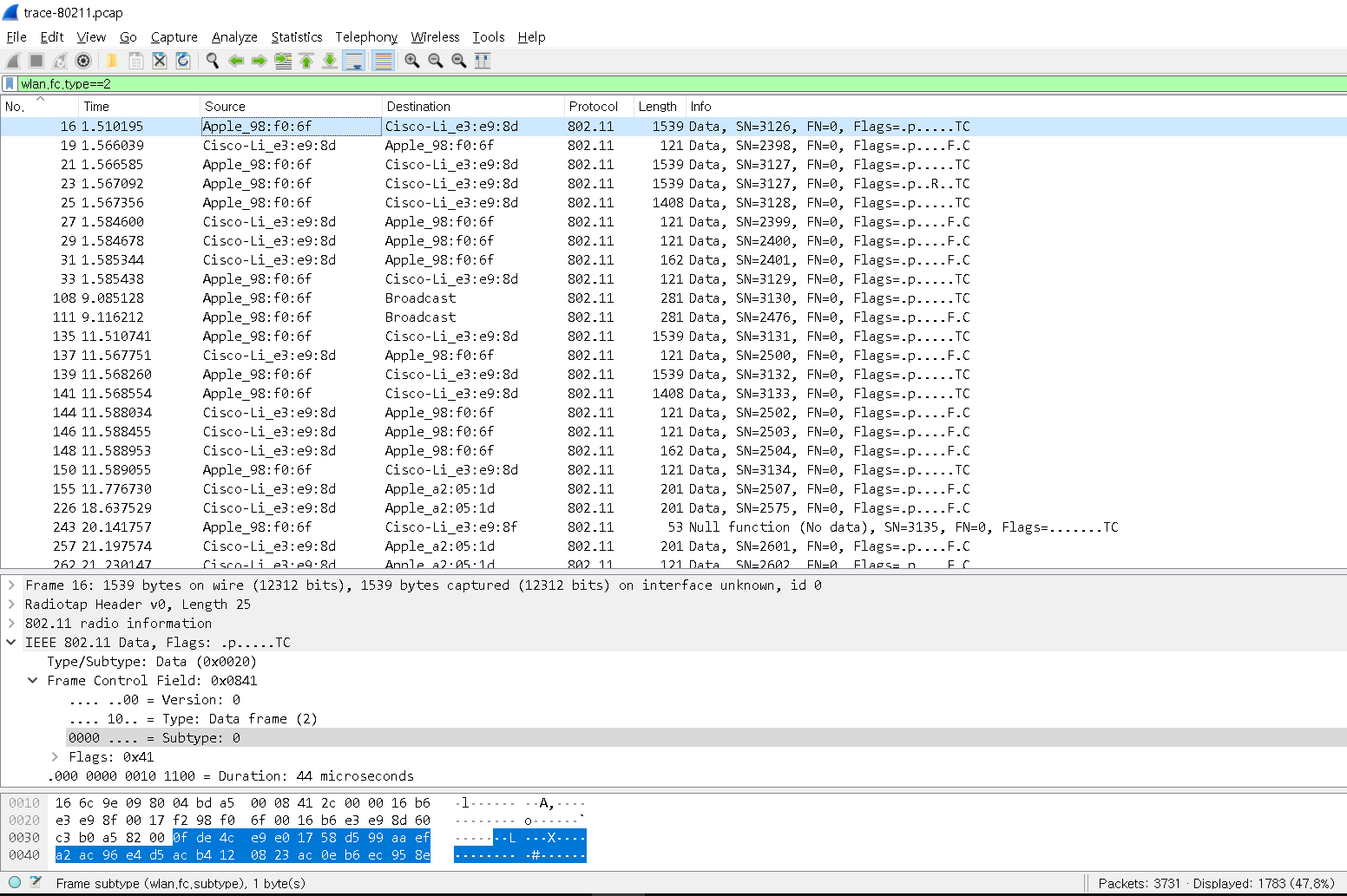
Wireless LAN: Data frame
How many data frames in the trace? What is the most common subtype of Data frame?
추적한 3731개의 패킷 중, 1783개의 패킷이 필터링되었고, 대부분은 Subtype : 0을 가지는 Data type의 패킷이다.

Slide 8
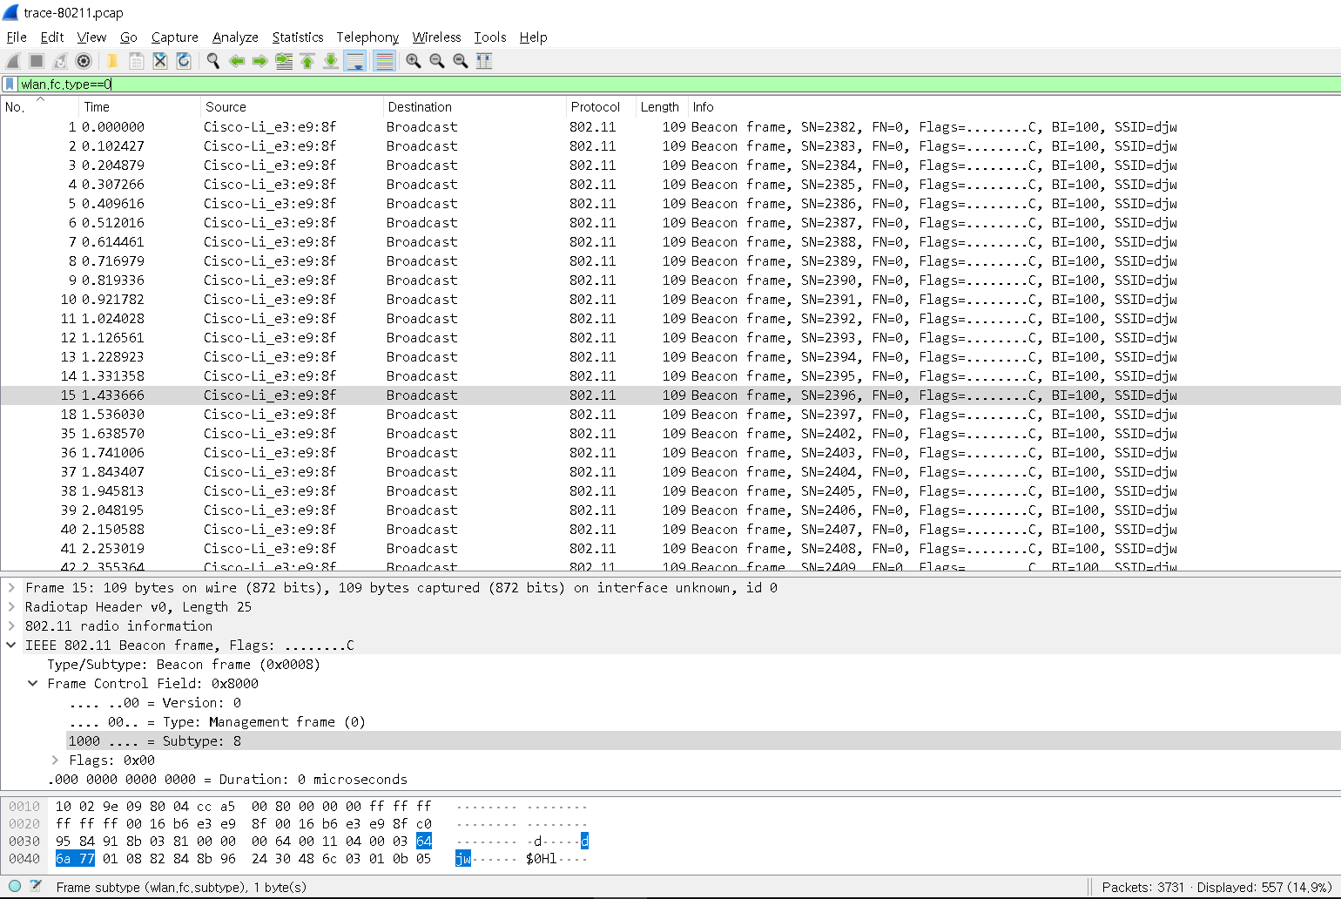
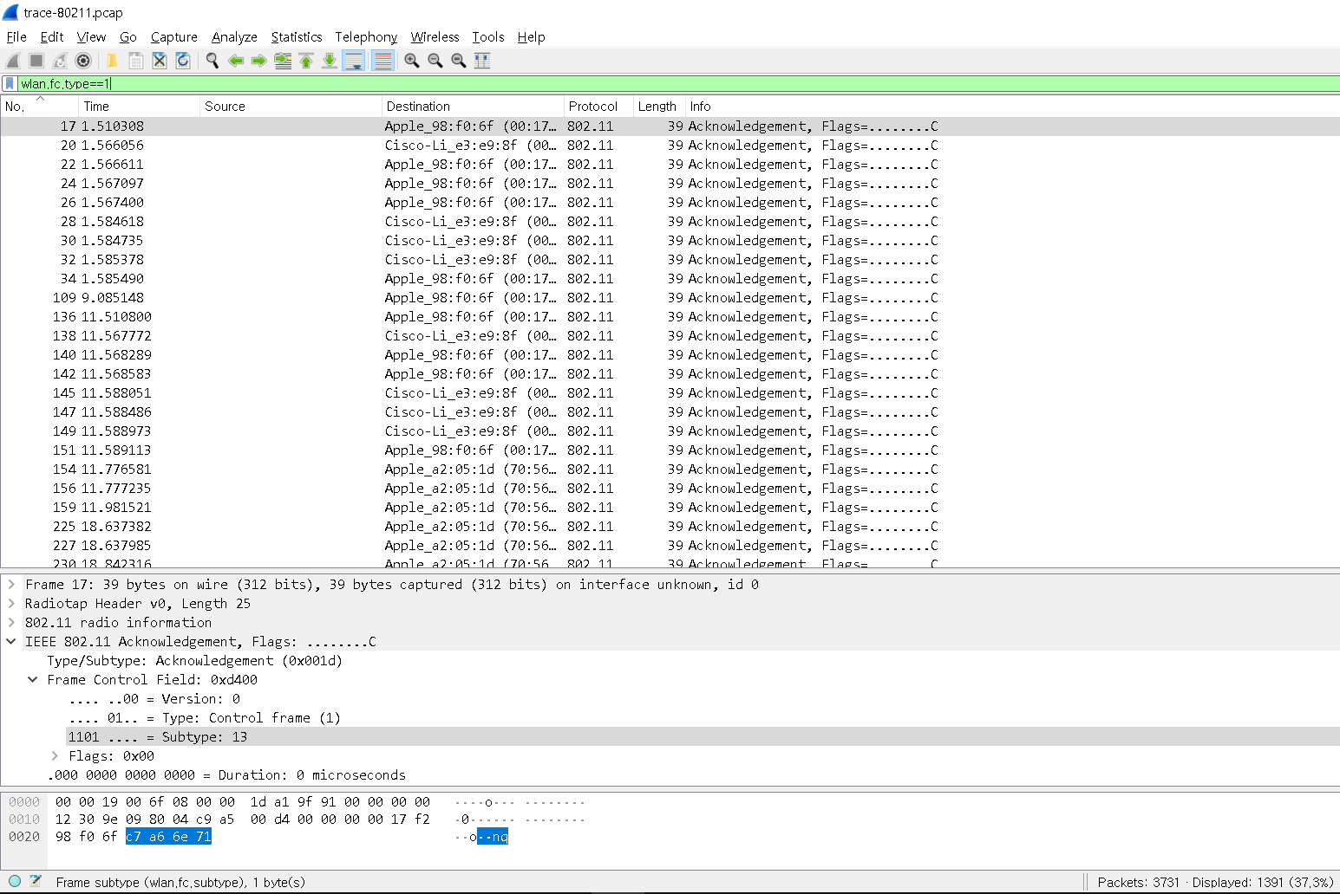
Wireless LAN: Control frame
Perform the same exercise for Control (Type 1) and Management (Type 0) frames by changing the filter expression to search for a different Type value.
How many control frames in the trace? How many management frames in the trace? What are the most common subtypes of Control frame and Management frame?
control frame은 1391개 발견되었고, management frame은 557개 발견되었다.
control frame은 대부분 Subtype : 13을 가지는 acknowledgement type의 패킷이었고, management frame은 대부분 Subtype : 8을 가지는 Beacon frame 이었다.

Slide 9
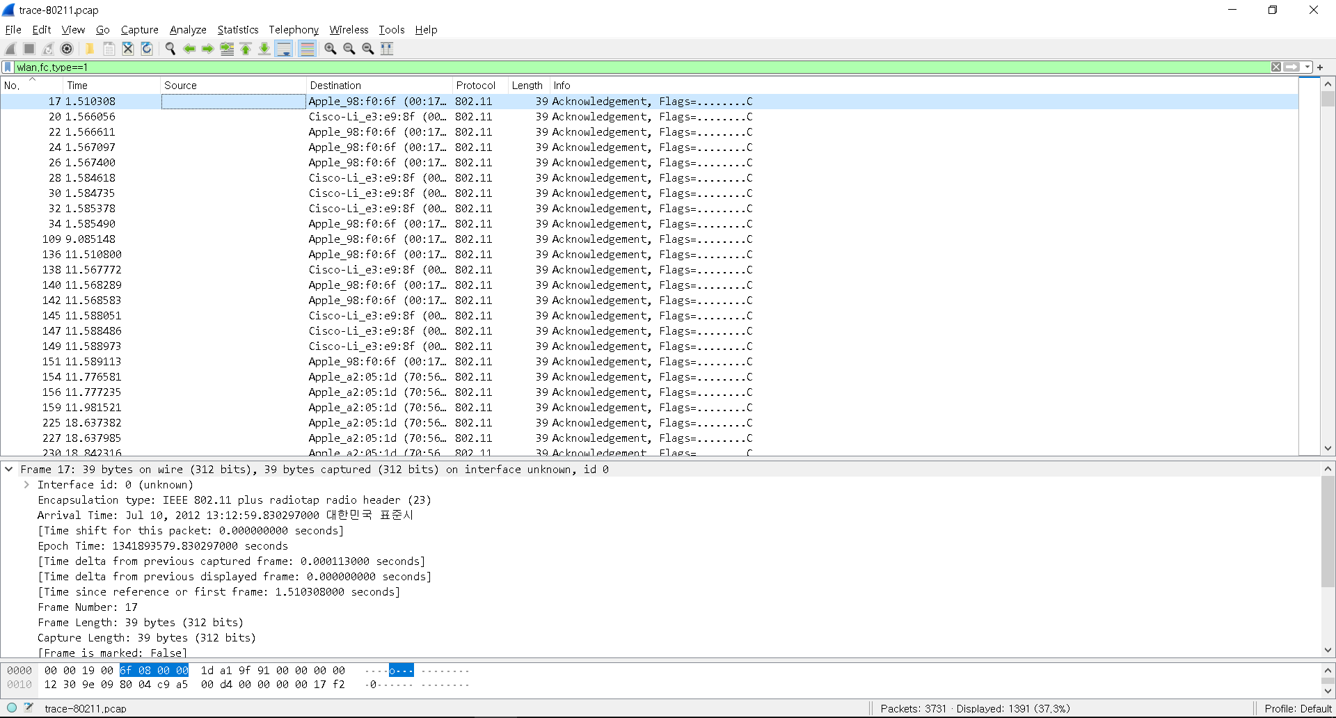
Wireless LAN: Control frame
- Inspect the IEEE 802.11 record of an Acknowledgement frame
List the fields in an Acknowledgement frame and their lengths in bytes.
전부 39 byte의 길이를 가진다.

Slide 10
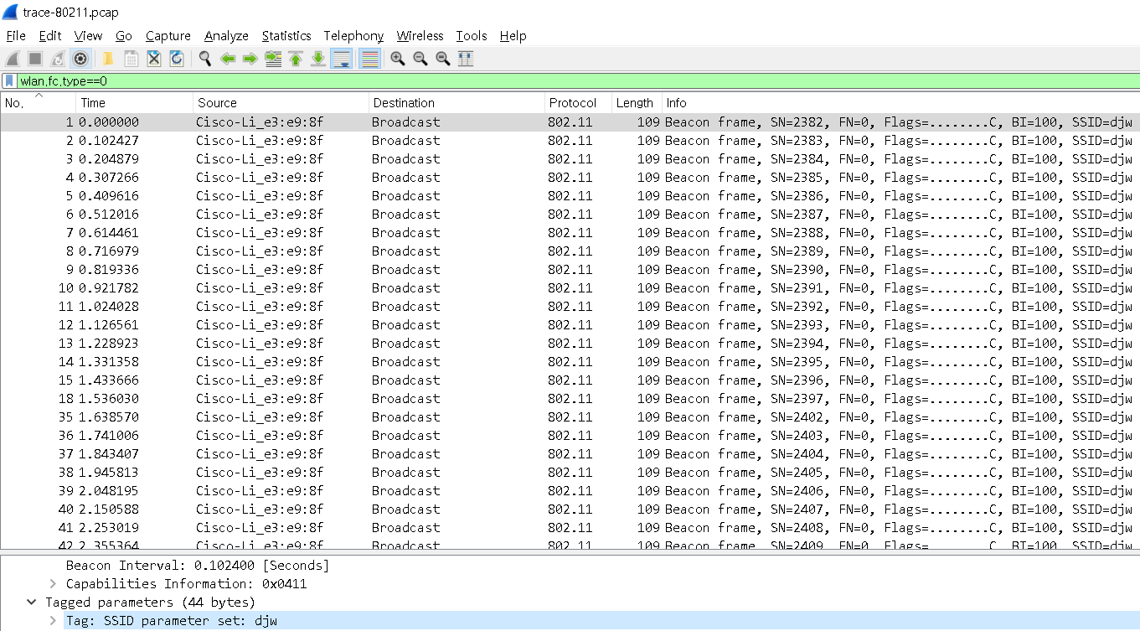
Wireless LAN: Beacon frame
Expand the payload of the Beacon frames to view its parameters and answer these questions:
What is the SSID of the main AP? This is one of the tagged parameters in the Beacon frame.
djw이다.

Slide 11
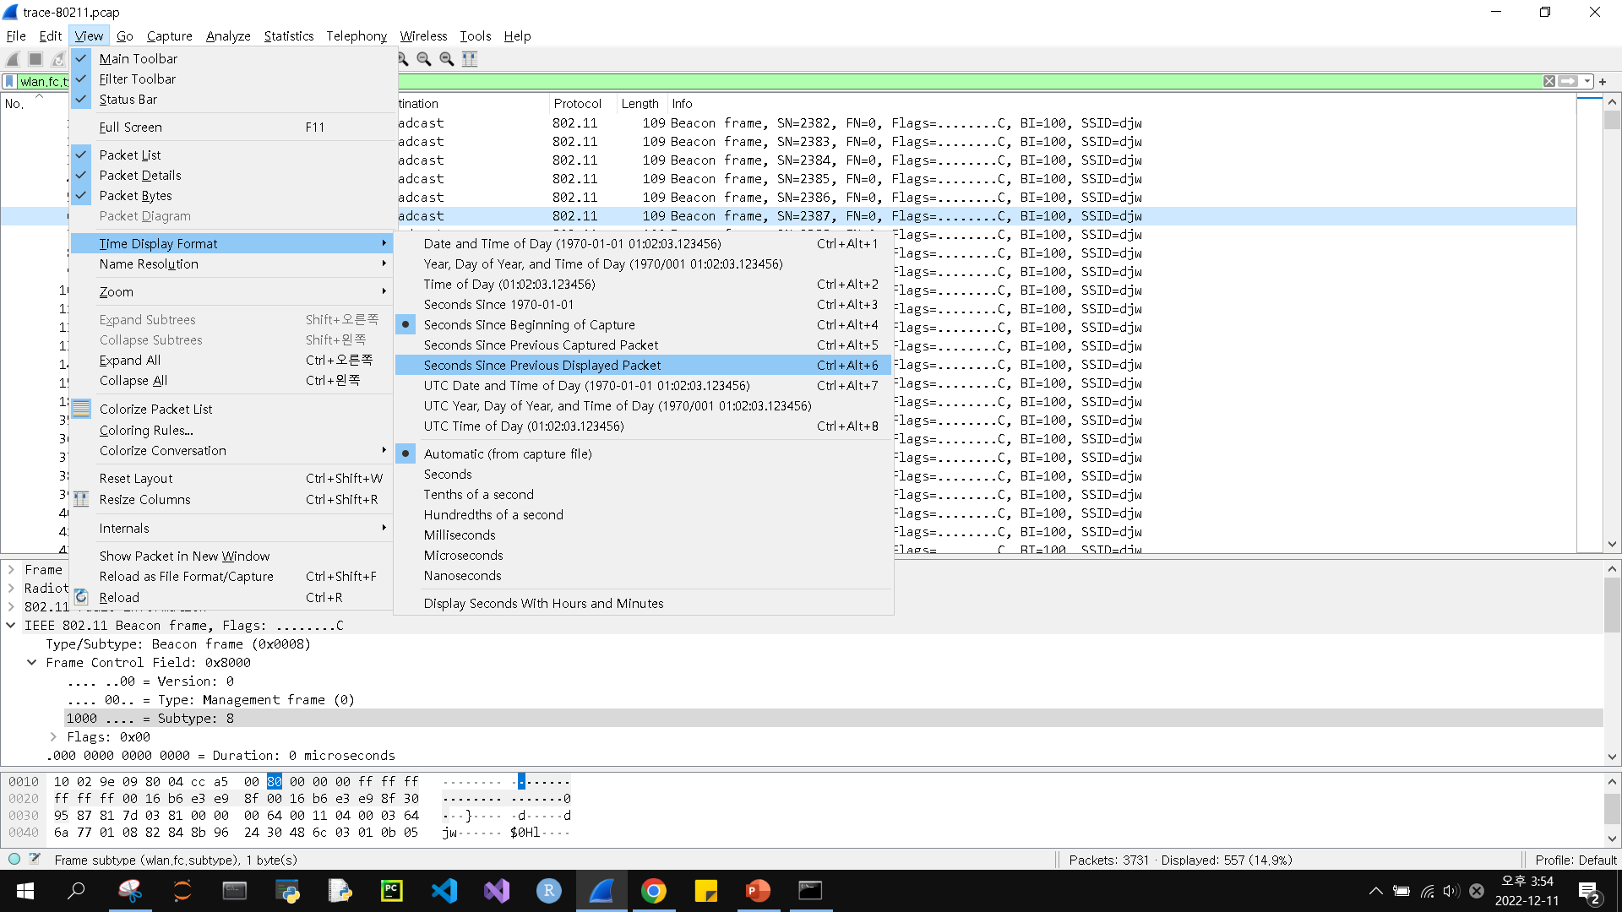
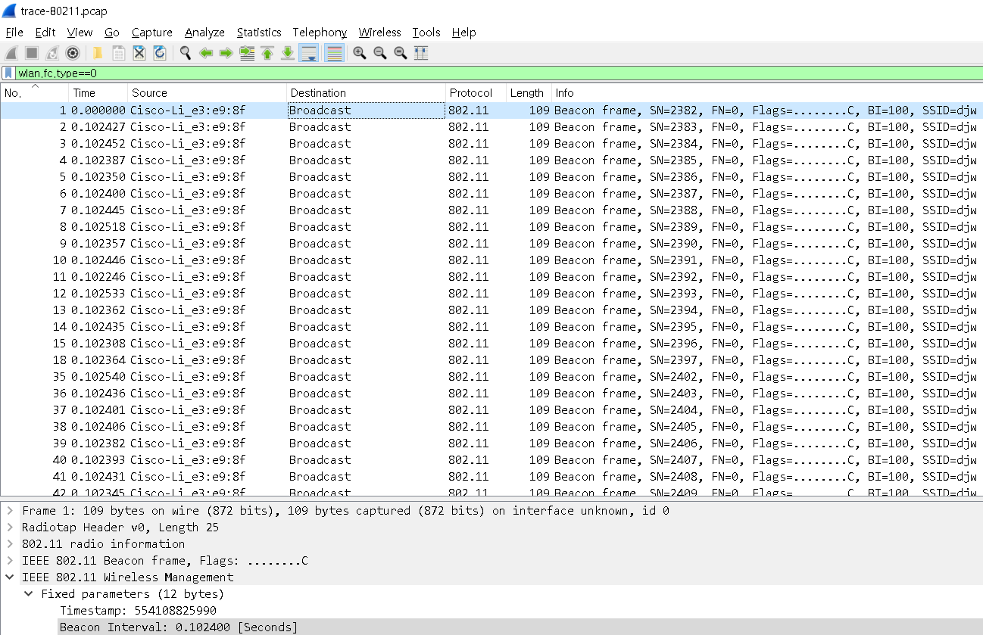
Wireless LAN: Beacon frame
- How often are Beacon frames sent for the main AP?
You may find the Beacon interval given in the Beacon frame itself, or change the Time display to be show the interval since the last frame. (Under View, select Time Display Format, and “Seconds Since Previous Displayed Packet”.)
Beacon Interval인 0.102400 sec마다 보낸다.

Slide 12
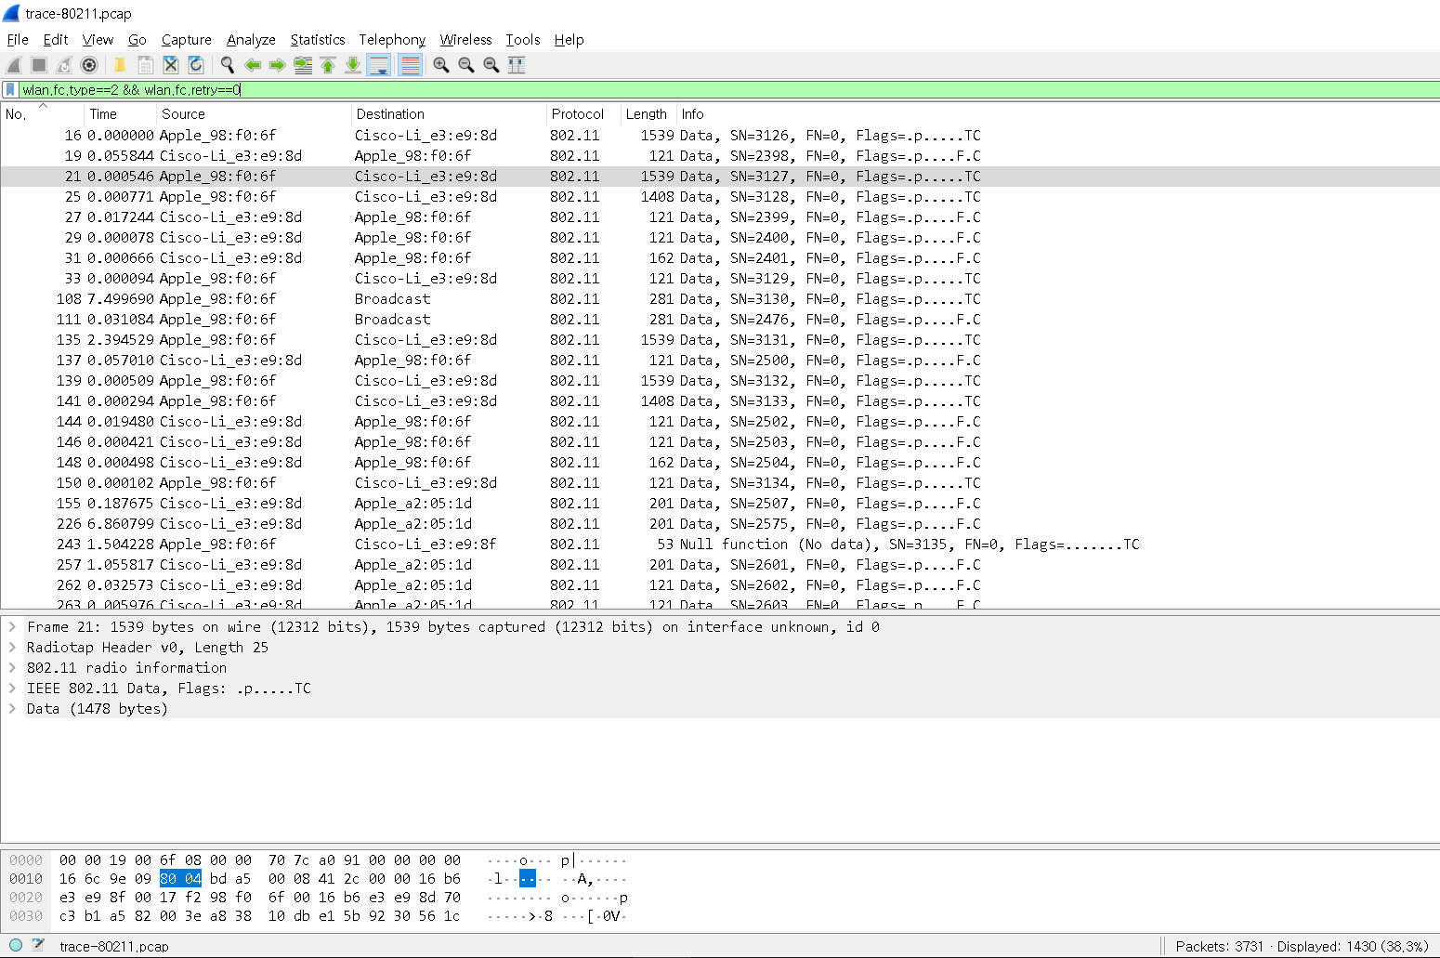
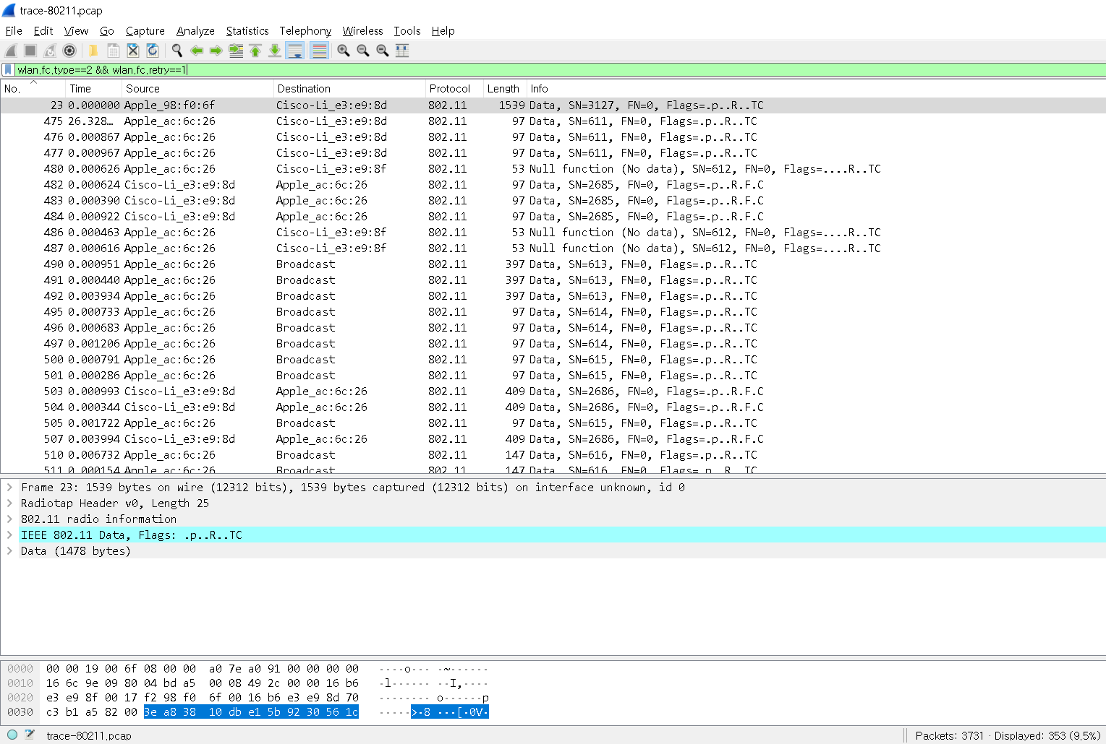
Wireless LAN: Retransmission ratio
Use filter expressions to find the number of data frames that are originals and retransmissions. For example, “wlan.fc.type==2 && wlan.fc.retry==0” will find original Data frames.
Give an estimate of the retransmission ratio as the number of retransmissions over the number of original transmissions. Explain how you obtained the result.
필터를 통해 얻은 원본 데이터 패킷의 수는 1430, 재전송된 패킷의 수는 353 이므로 재전송률은 353/1430. 약 24.7% 이다.

